Slide 1

CO5-ASSESSMENT TOOL-2(TECHNICAL PRESENTATION)
How Would You Present Your Simulation Results to a Client?
Presented by
RUCHITA.S (192572081)
CSA0706-COMPUTER NETWORKS

Slide 2

INTRODUCTION
What is Network Simulation?
Network simulation is used to test a network virtually.
It helps us check network performance before actual implementation.
It can identify problems such as:
Network delay
Packet loss
Congestion
Low data transfer speed
Simulation results help the client make better decisions.
Example: Cisco Packet Tracer can be used to simulate a computer network.

Slide 3
IMPORTANT NETWORK PERFORMANCE PARAMETERS
What Results Should We Show?
Parameter | Meaning
Throughput | Amount of data successfully transferred
Delay | Time taken for data to reach the destination
Packet Loss | Packets that do not reach the destination
Network Availability | How reliably the network operates

Slide 4
HOW TO PRESENT SIMULATION RESULTS
Present Results Clearly
Use graphs and charts to show performance.
Use tables for important values.
Compare before and after improvements.
Use a simple network diagram to explain the setup.
Highlight the most important results.
Avoid unnecessary technical details.

Slide 5
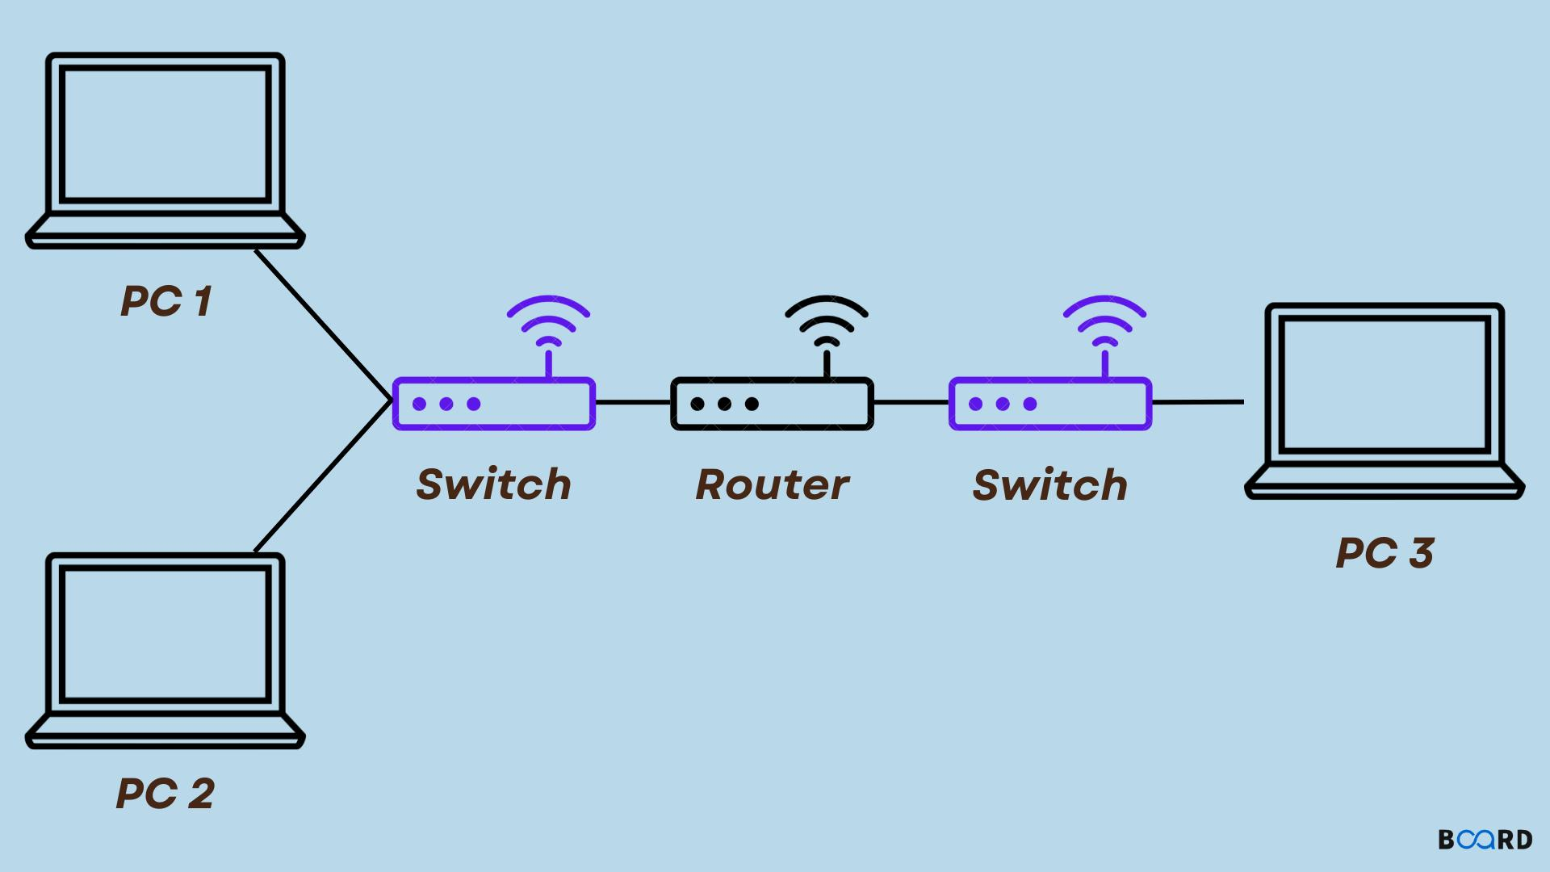
EXAMPLE OF NETWORK SIMULATION
Network: PCs → Switch → Router → Server
Sample Simulation Results
Throughput: 85 Mbps
Average Delay: 20 ms
Packet Loss: 2%
Interpretation: The network can transfer data efficiently with relatively low delay and packet loss.
Simple Network Setup

Slide 6
BEFORE VS AFTER IMPROVEMENT
Network Performance Comparison
Parameter | Before Improvement | After Improvement
Throughput | 60 Mbps | 85 Mbps
Delay | 40 ms | 20 ms
Packet Loss | 6% | 2%
Result
Throughput increased.
Delay decreased.
Packet loss decreased.
Overall network performance improved.
This comparison makes it easy for the client to see the benefit of the proposed solution.

Slide 7
CONCLUSION
Network simulation helps us test and evaluate a network before deployment.
Important results should be presented using simple graphs, tables, and diagrams.
Parameters such as throughput, delay, and packet loss show network performance.
Before-and-after comparisons clearly show the improvement.
A clear presentation helps the client understand the results and make the right decision.

Slide 8
THANK YOU

